Slide 1
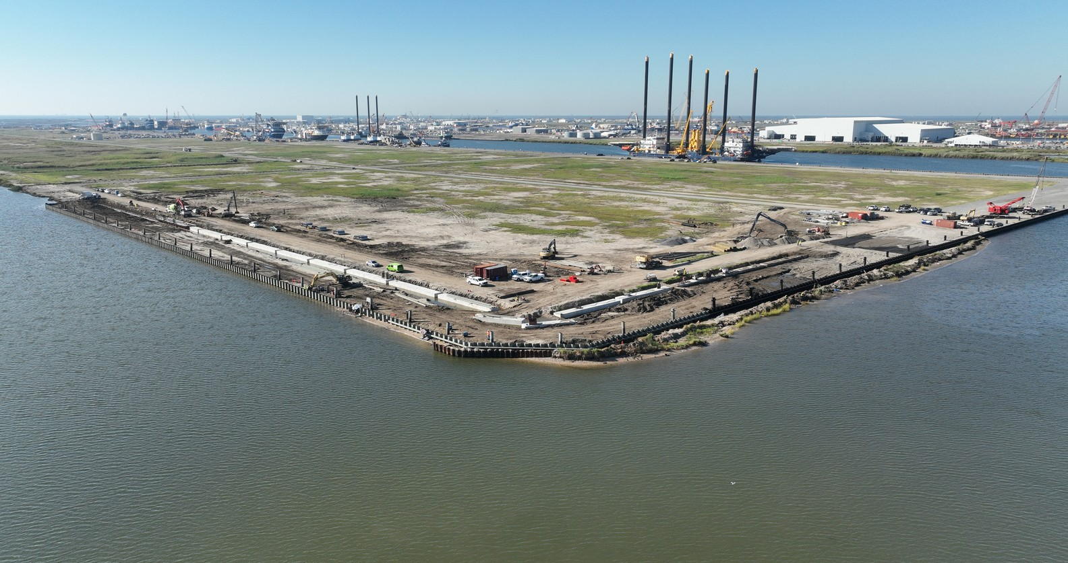

DYNAMICGRP.COM
SPACEX LOUISIANA SUPPLIER DAY · OCTOBER 2026
DYNAMIC GROUP
ZACH BUTTERWORTH, CEO
JOSH MCCOY, EXECUTIVE CHAIRMAN
JOHN AUSTIN, EXECUTIVE VICE PRESIDENT
zachb@dynamicgrp.com
jmccoy@dynamicgrp.com
jaustin@dynamicgrp.com
Notes:
Introduce Dynamic Group and every company in attendance. One combined session, 10 to 15 minutes.

Slide 2


Slide 3

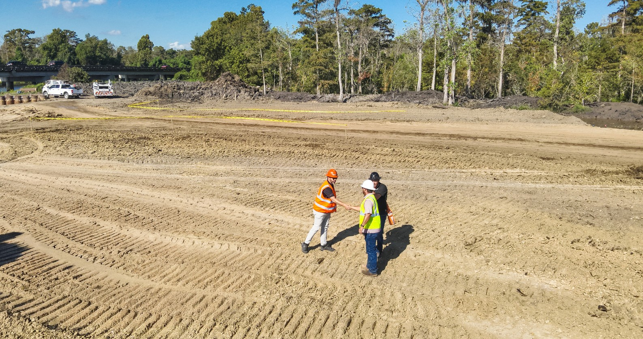
SPACEX LOUISIANA SUPPLIER DAY
SAFETY TOPIC · AWARENESS ON THE LOUISIANA COAST
SAFETY IS A CORE VALUE
SOFT GROUND
HEAT
Marsh and fresh fill give way. Stay on matting.
Drink water early and take shade breaks.
WEATHER
WATER & WILDLIFE
Hear thunder, get off the levee and out of the water.
Life jacket on every boat. Watch for wildlife.
Every person on site has stop work authority.
02
Notes:
Safety is a core value. Safety topic for engineers new to a Louisiana coastal site.

Slide 4
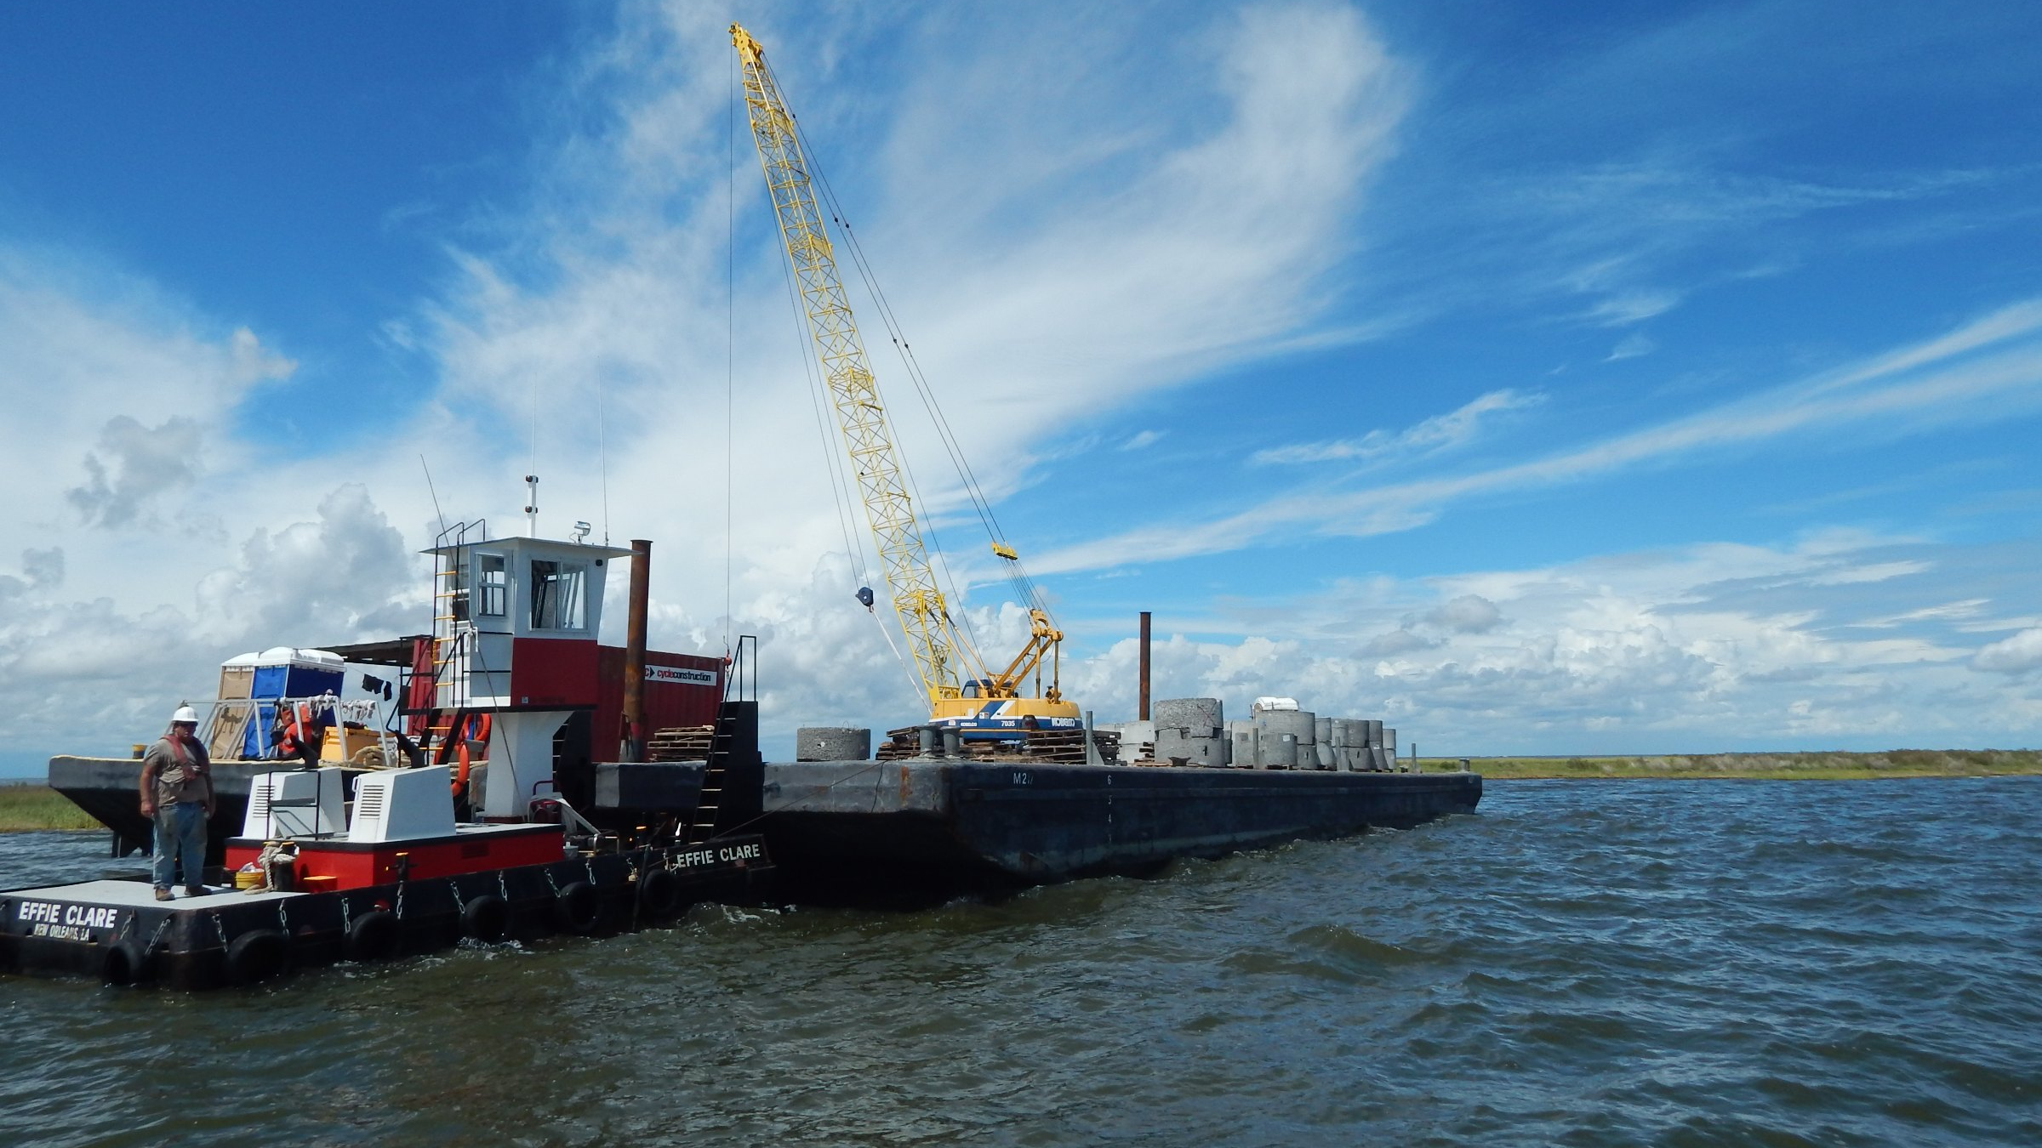
SPACEX LOUISIANA SUPPLIER DAY
CONTENTS
TABLE OF CONTENTS
01
WHO WE ARE
Pages 02–05
02
WHAT WE CAN DO FOR SPACEX
Pages 06–12
03
RECENT PROJECTS
Pages 13–18
03
Notes:
Three topics: who we are, what we can do for SpaceX, recent projects. Regenerate page ranges when slides change.

Slide 5
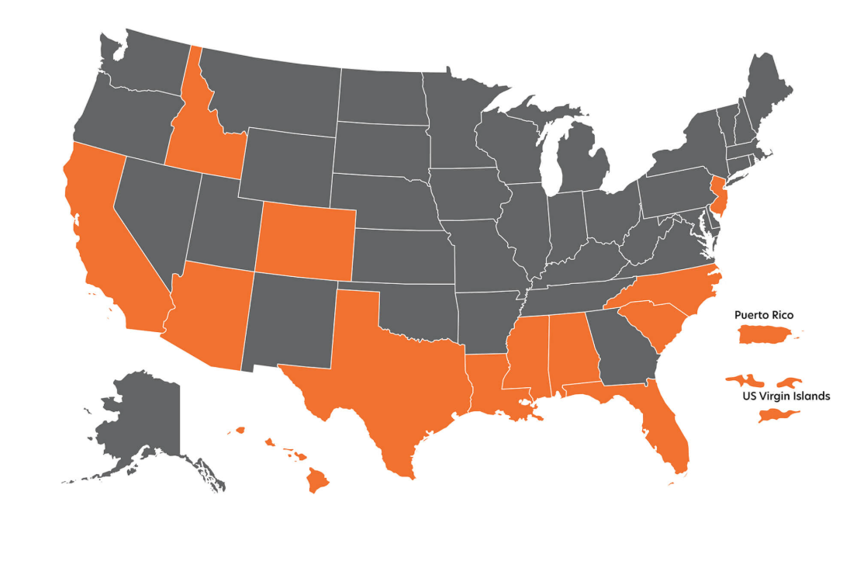
SPACEX LOUISIANA SUPPLIER DAY
COMPANY OVERVIEW
DYNAMIC GROUP AT A GLANCE
Dynamic Group is a national general contractor with self-performed capabilities across heavy civil construction, building construction, and emergency response. Our civil division handles grading, drainage, subsurface utilities, pile driving, marine construction, and deep foundation work, giving clients direct control over schedule, quality, and cost. Our building division constructs commercial, industrial, and government facilities, and manages large-scale residential programs. With more than 25 years of experience, Dynamic is building the future.
Marine & Civil Construction Division
Housing Division
Mission Critical Division
Building Construction Division
Emergency Response Division
HQ: BATON ROUGE, LA
$300M
1.9M
400+
982
ESTIMATED 2026 REVENUE
ESTIMATED 2026 MANHOURS
PIECES OF OWNED EQUIPMENT
TOTAL HEADCOUNT
Including Amphibious + Marine Equipment
368 Direct · 92 Indirect · 522 Contracted
04
Notes:
Josh McCoy and his wife Kelli, a NICU nurse, founded Dynamic around their kitchen table on Josh's belief that he could build homes faster and better than the largest developers. From that kitchen table, Dynamic has grown to a company that will do around $300M in revenue this year, with nearly 500 direct employees and another 600 craft on our sites delivering heavy civil, coastal restoration, data center construction and homebuilding.

Slide 6
SPACEX LOUISIANA SUPPLIER DAY
STABILITY & FINANCIAL HEALTH
CAPITALIZED TO CARRY THE WORK
We finance mobilization, equipment, and payroll from our own balance sheet and credit facilities, so crews stay on schedule without waiting on progress payments.
$700M
90%
$1B+
LINE OF CREDIT
CREDIT CAPACITY AVAILABLE
ACTIVE PROJECTS
DUN & BRADSTREET PROFILE
SURETY
PAYDEX score
77
Surety and rating
Zurich, A+ (Superior)
D&B rating
1R3
Rating as of Sept 2021
05
Notes:
Liquidity, surety and third-party credit view. D&B figures pending Marcy.

Slide 7
SPACEX LOUISIANA SUPPLIER DAY
CAPACITY
SOLUTIONS FOR SPACEX
200,000
→
400,000
01
SAND DELIVERY
Tons delivered each month
Tons per month, the ability to scale to
≈148,000 cubic yards
≈296,000 cubic yards
1,000
02
WORKFORCE HOUSING
Beds in 5 months
750+
1,500
03
CIVIL CONSTRUCTION
Pieces of working equipment
Workforce
06
Notes:
We have been able to take work away from larger contractors.
- Last 3 yrs, we moved 3M tons of material, including 87 miles barge, truck, set
- As a company, we've delivered as many as 140 houses in a single month and 1200 homes in a year
- Example on a recent project, pay well, 4mo 17 → 400 people
- Do it by being honest with clients and transparent about what wages need to be
- Largest contractors are suffocated by their own scale; can’t raise rates on jobs and pay $5/hr more.
- Dynamic is working on Select mega sites – Alexandria, Shreveport
- Want to grow, attitude of growth
Capacity today - we can show you via our current projects

Slide 8
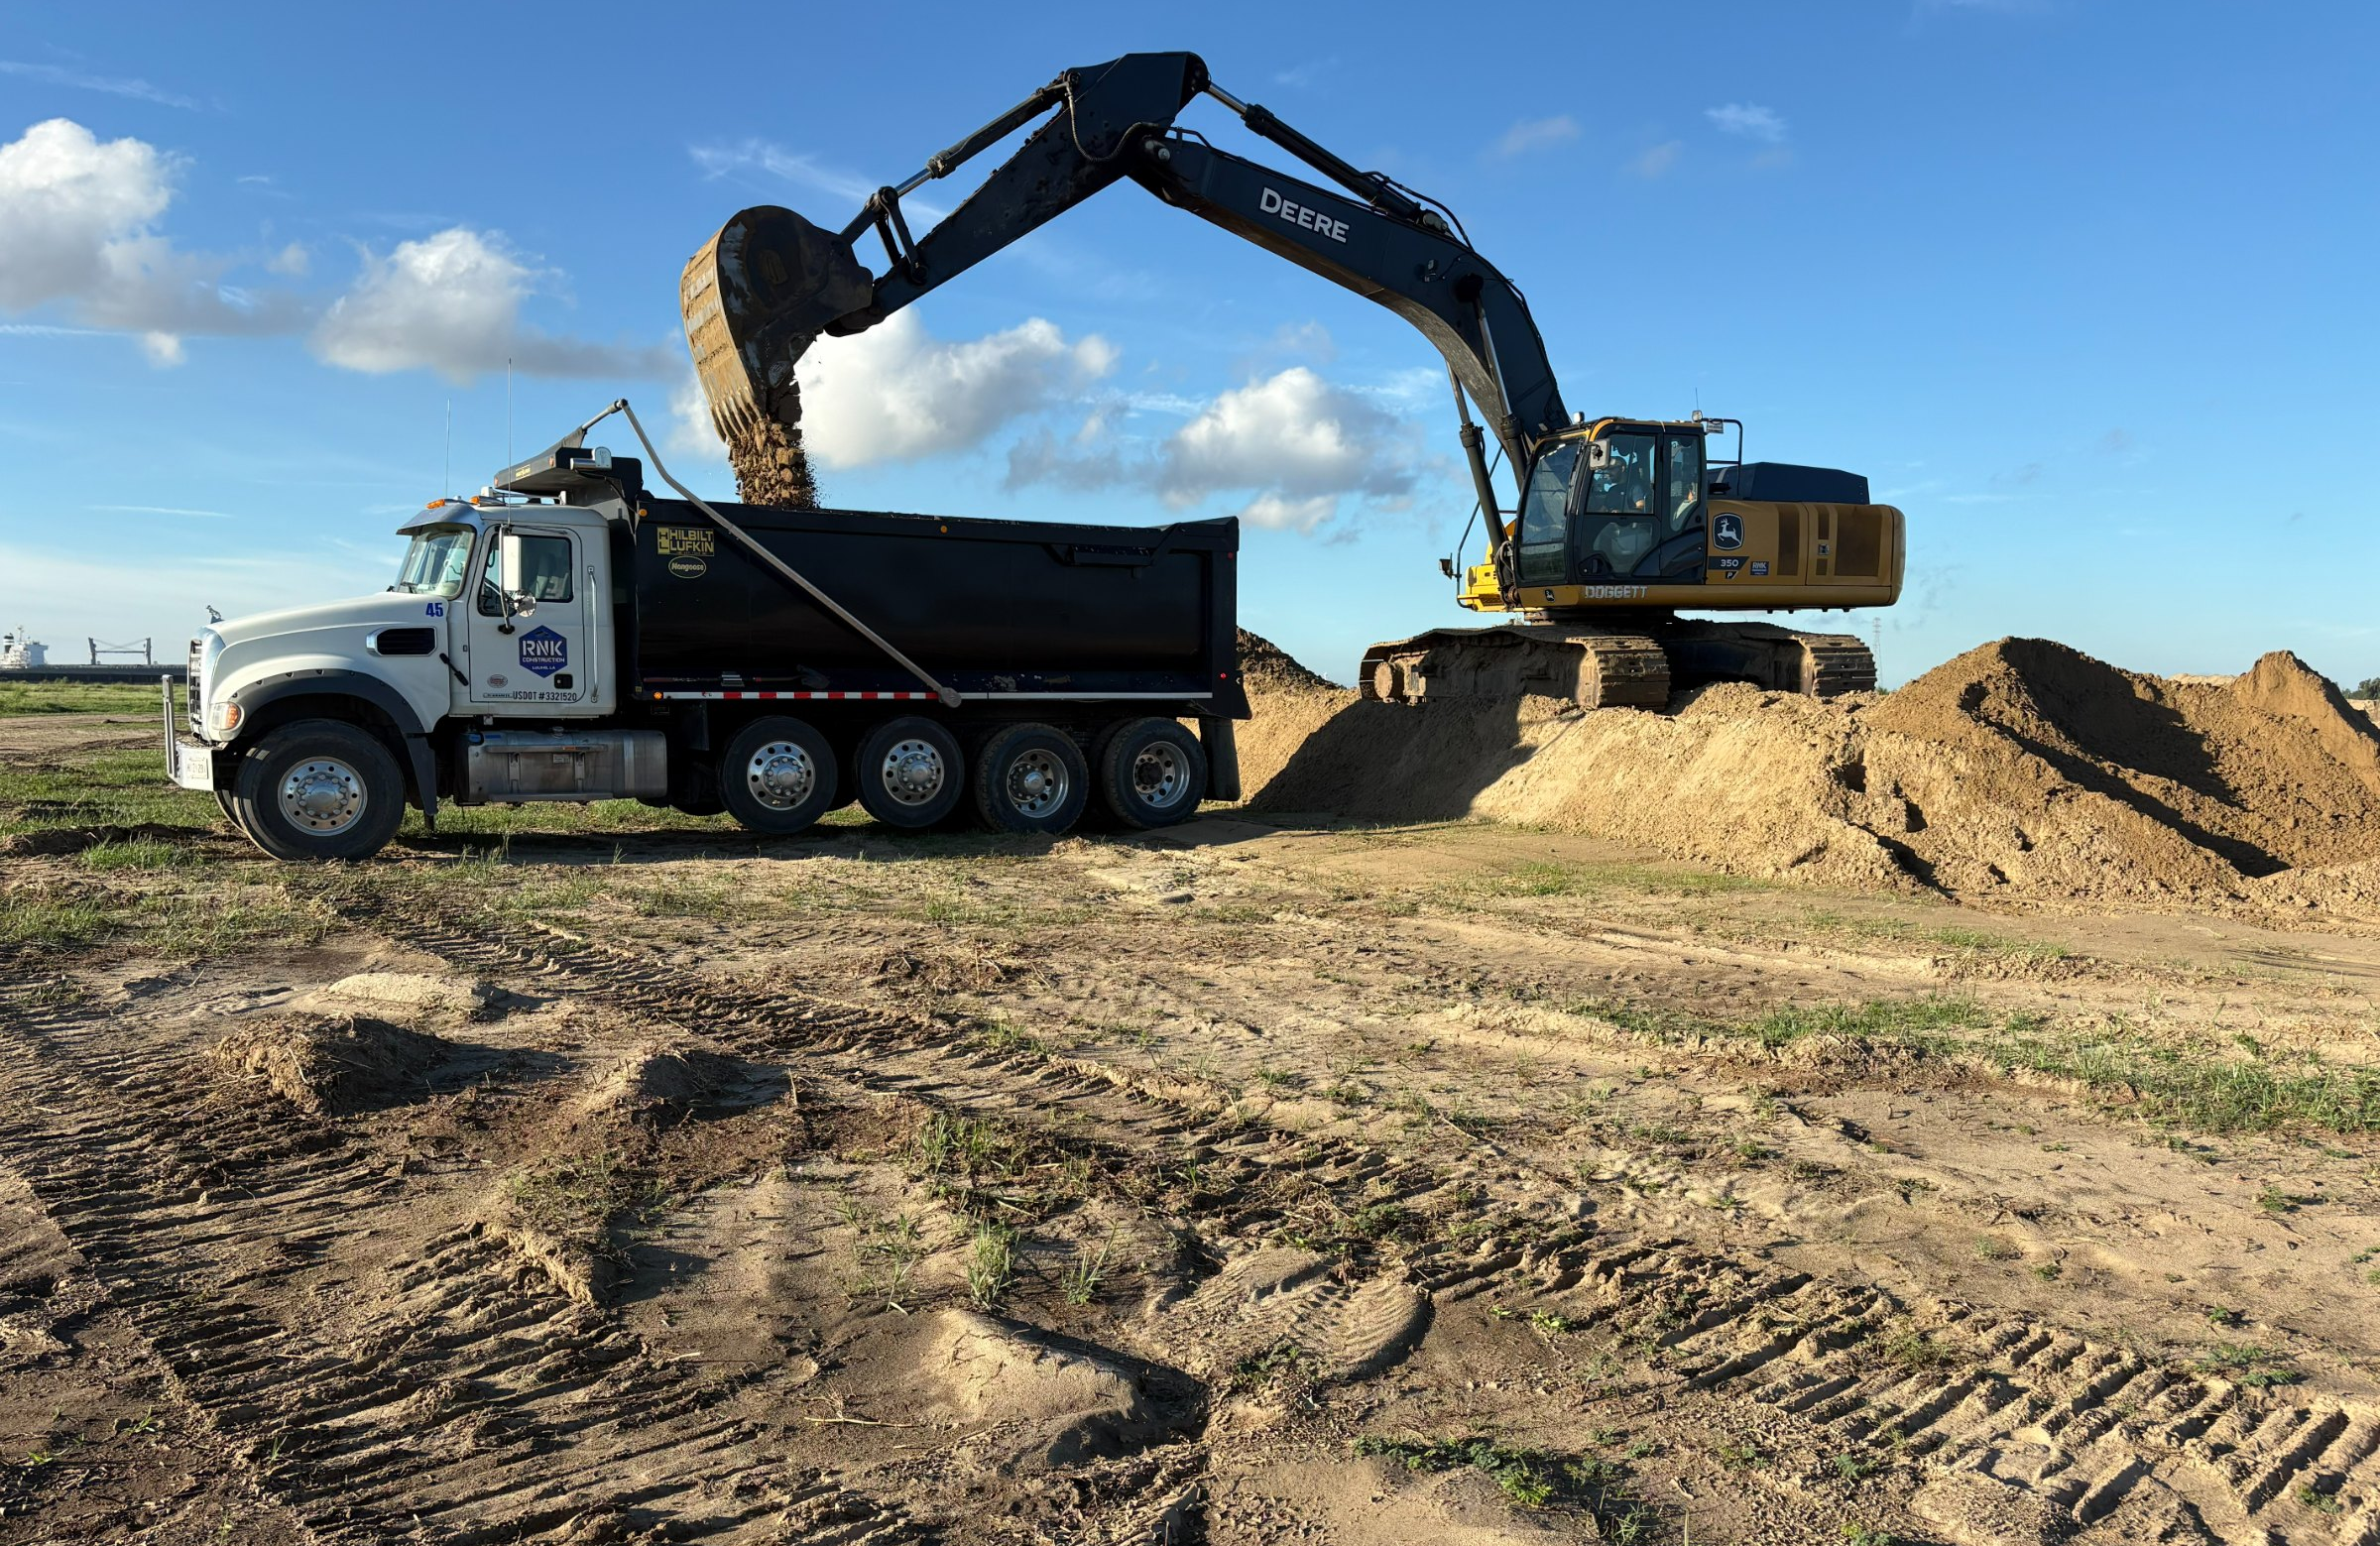
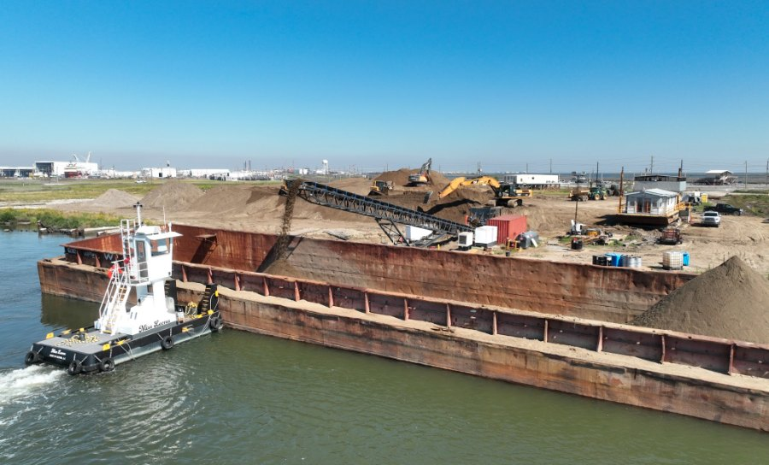
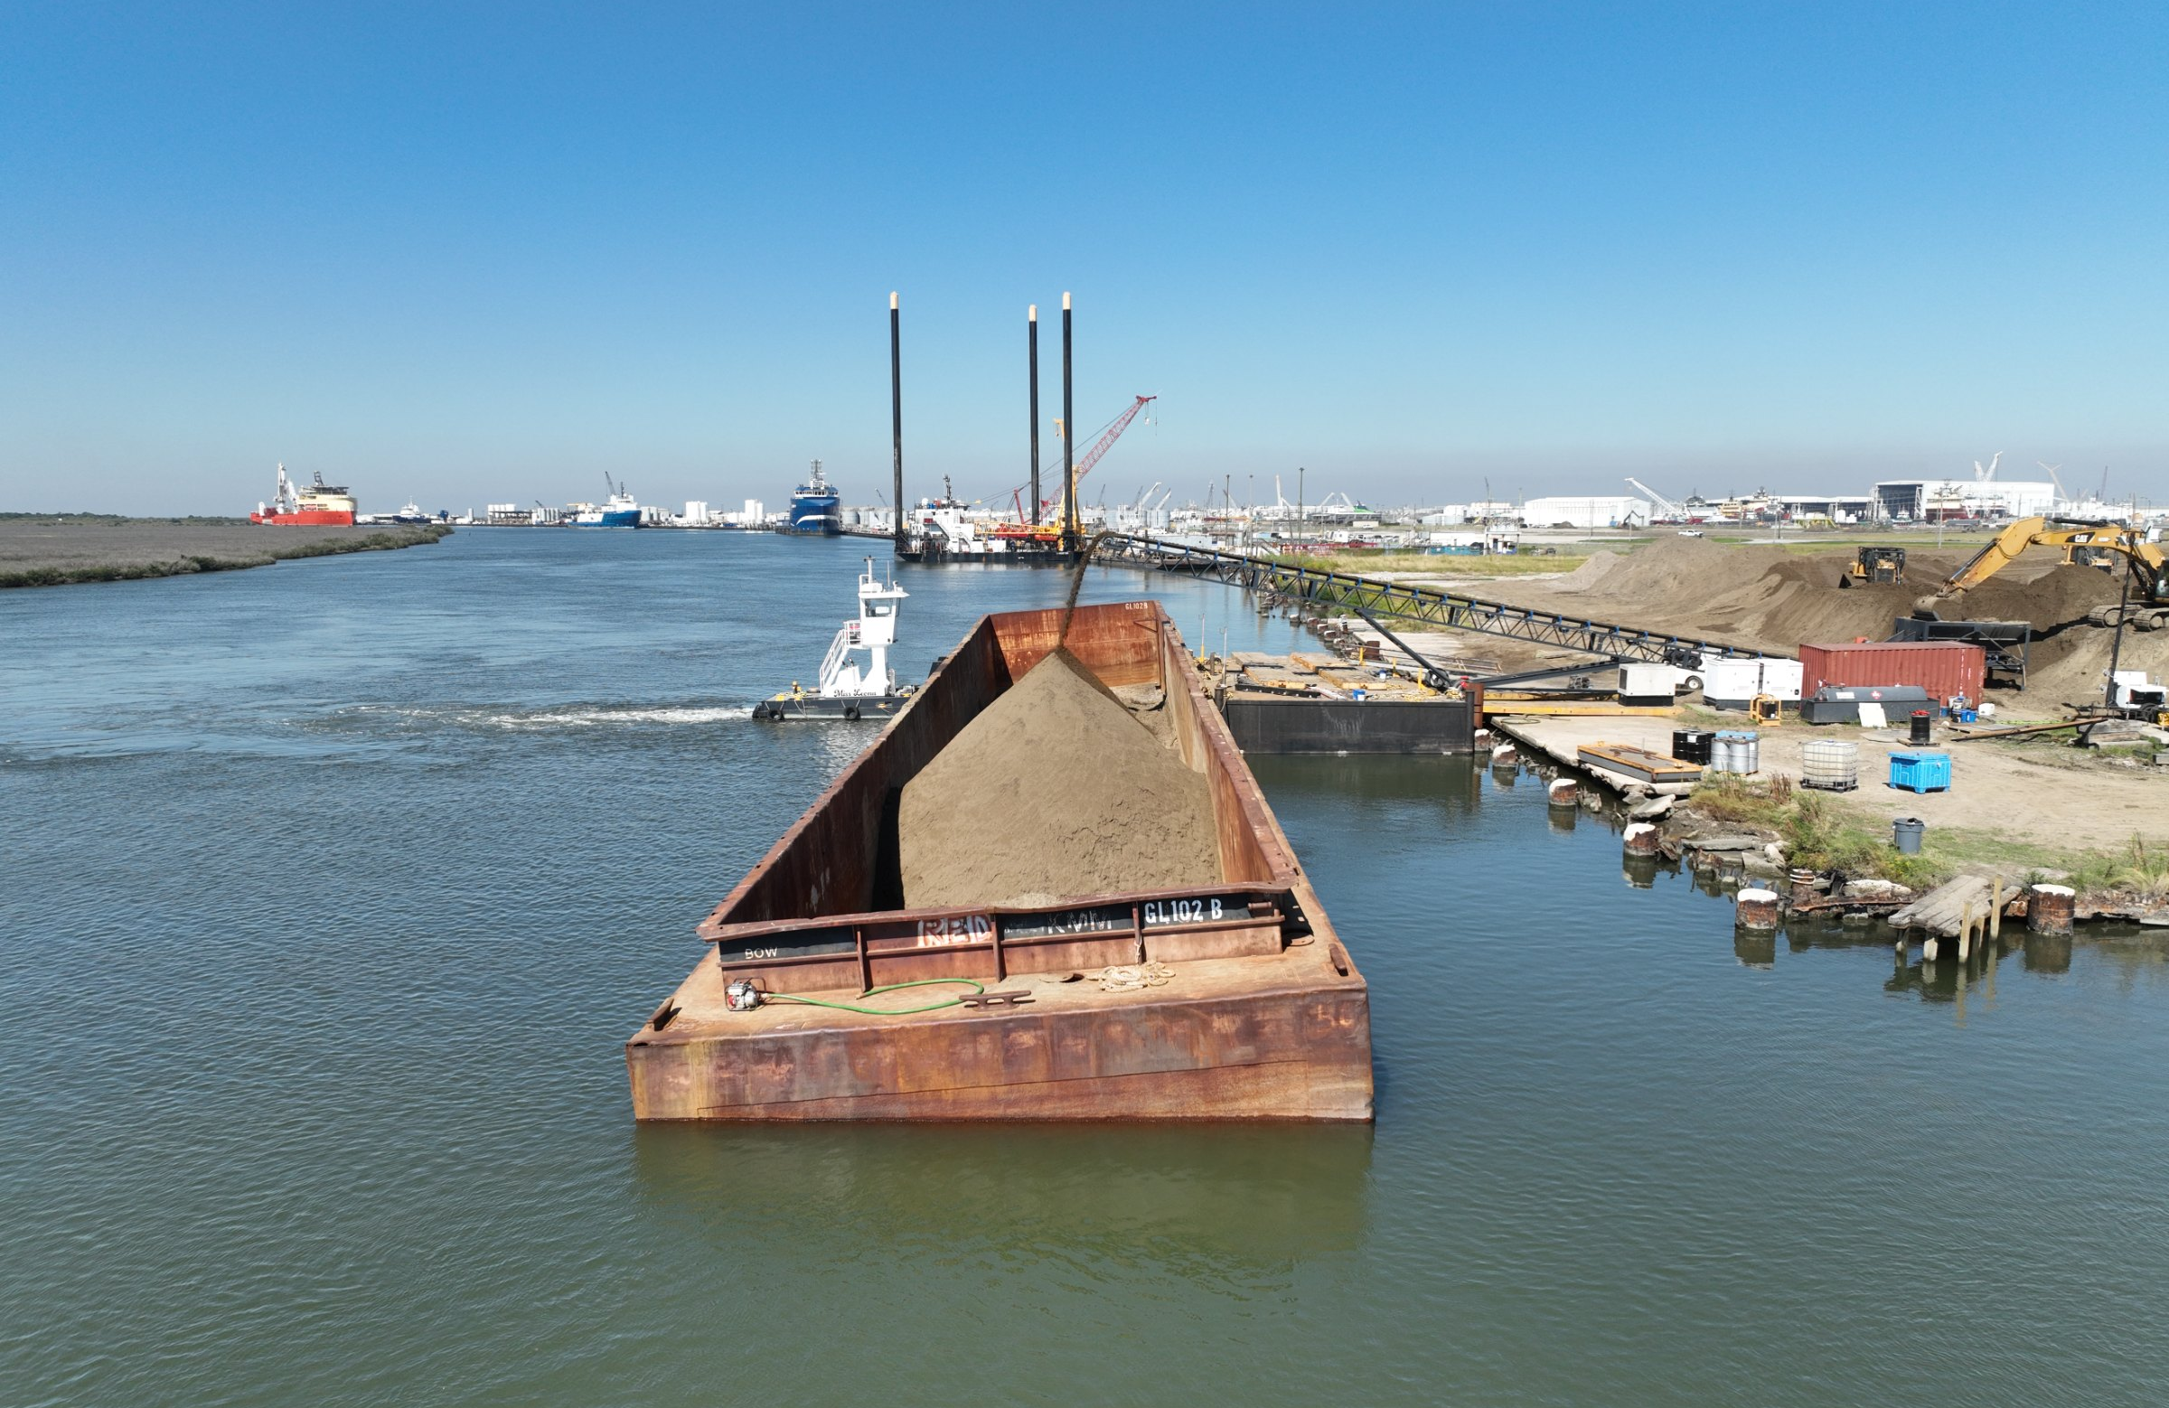
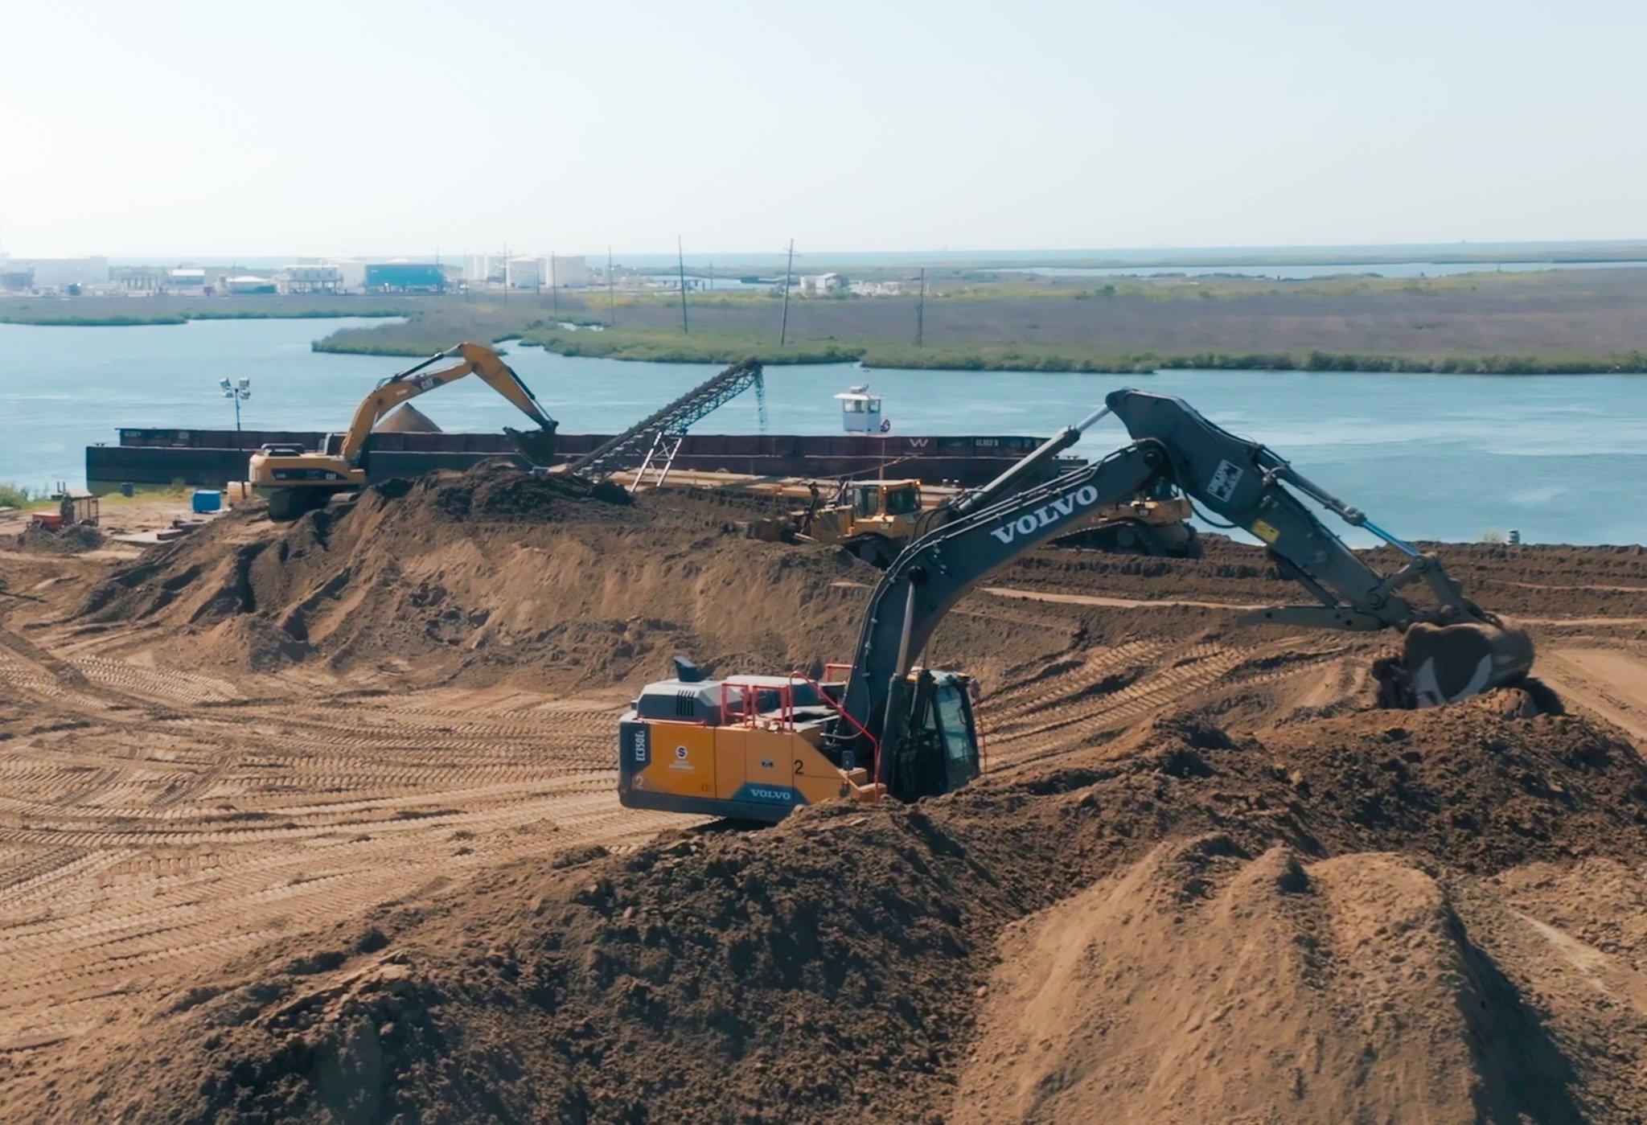
SPACEX LOUISIANA SUPPLIER DAY
CAPABILITY 01 · MARINE CONSTRUCTION
NO PERMIT NEEDED* SAND PLAN
MANIACAL URGENCY
Dynamic moves massive quantities of material to build storm protection systems and stabilize coastal land. We are offering to source, haul, barge, and place 5,000,000 tons of sand at Pecan Island.
5M
*Dynamic's sourcing and transportation supply chain requires no new permits.
TONS DELIVERED TO PECAN ISLAND
1
SOURCE
2
HAUL
3
BARGE
4
PLACE
Qualify sand borrow sources within economical haul distance of Vermilion Parish, set up DOTD‑certified truck scales, and confirm material gradation against the site’s fill specification.
Trucking to the established yard, with 3 loading sites where sand will be received and loaded on barges.
Load barges by conveyor at the staging yard and move sand through the Intracoastal Waterway to the Pecan Island site.
Place sand with amphibious excavators, dump wagons, and bulldozers on accessible ground. We have the capacity to offload all barges.
SOURCE
CONVEYOR
BARGE
PLACEMENT
07
Notes:
We have the crews who just finished moving 3M tons
We have the crews and equipment available
Can build a monthly projection to get your 5M tons

Slide 9
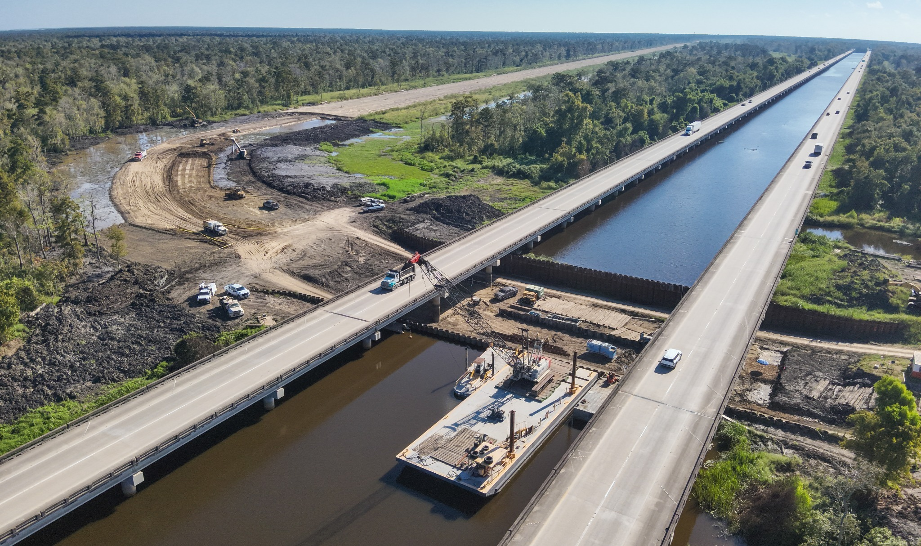
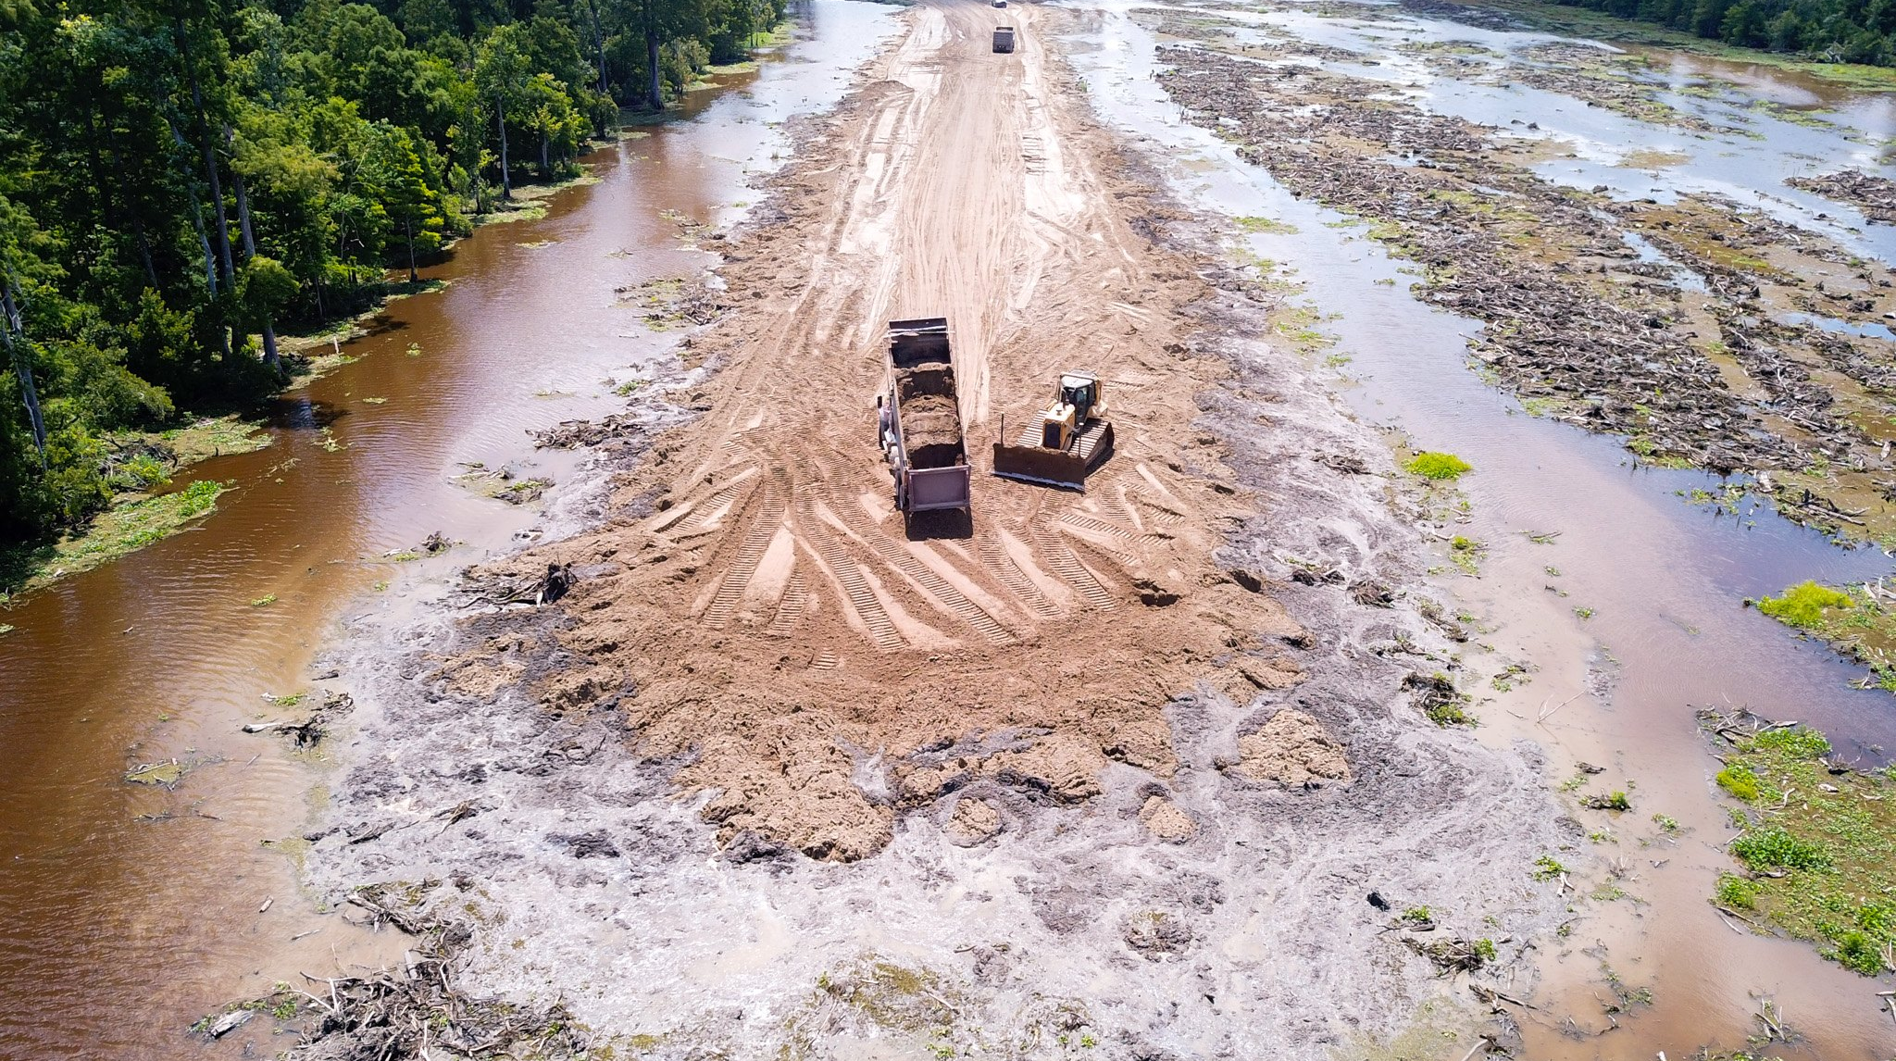
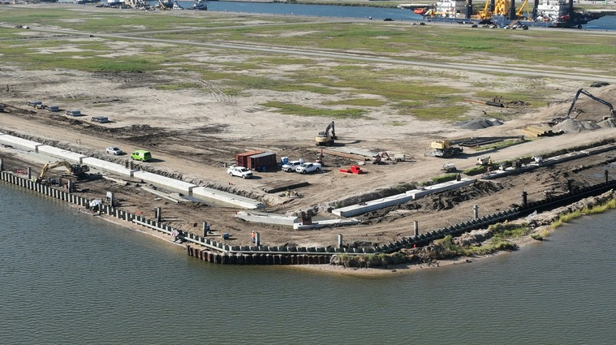
SPACEX LOUISIANA SUPPLIER DAY
CAPABILITY 01 · MARINE CONSTRUCTION
PILE DRIVING, HAUL ROADS & RETAINING STRUCTURES
3.1M
Self-performed marine and waterfront civil work with owned equipment and experienced marine crews, from material supply through final embankment.
CUBIC YARDS OF MATERIAL PLACED
Projects currently underway
Pile driving: sheet, pipe, precast
Levee construction
Retaining structures
Sand supply and placement
Haul roads
Dredging
RETAINING STRUCTURES
SAND PLACEMENT IN MARSH
PILE DRIVING
08
Notes:
Pile driving, levees, retaining structures, sand supply and haul roads.

Slide 10
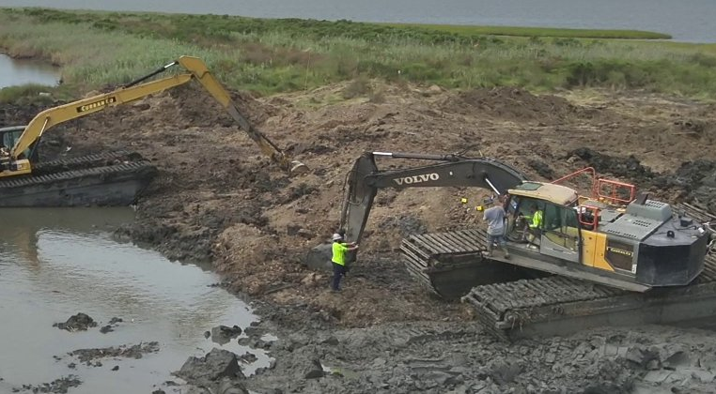
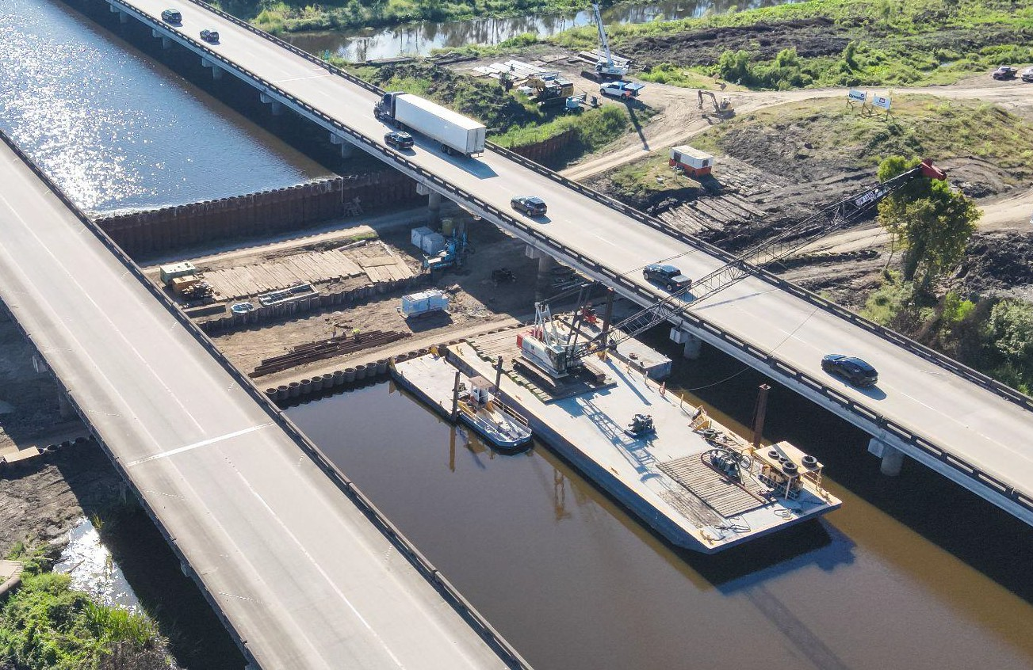
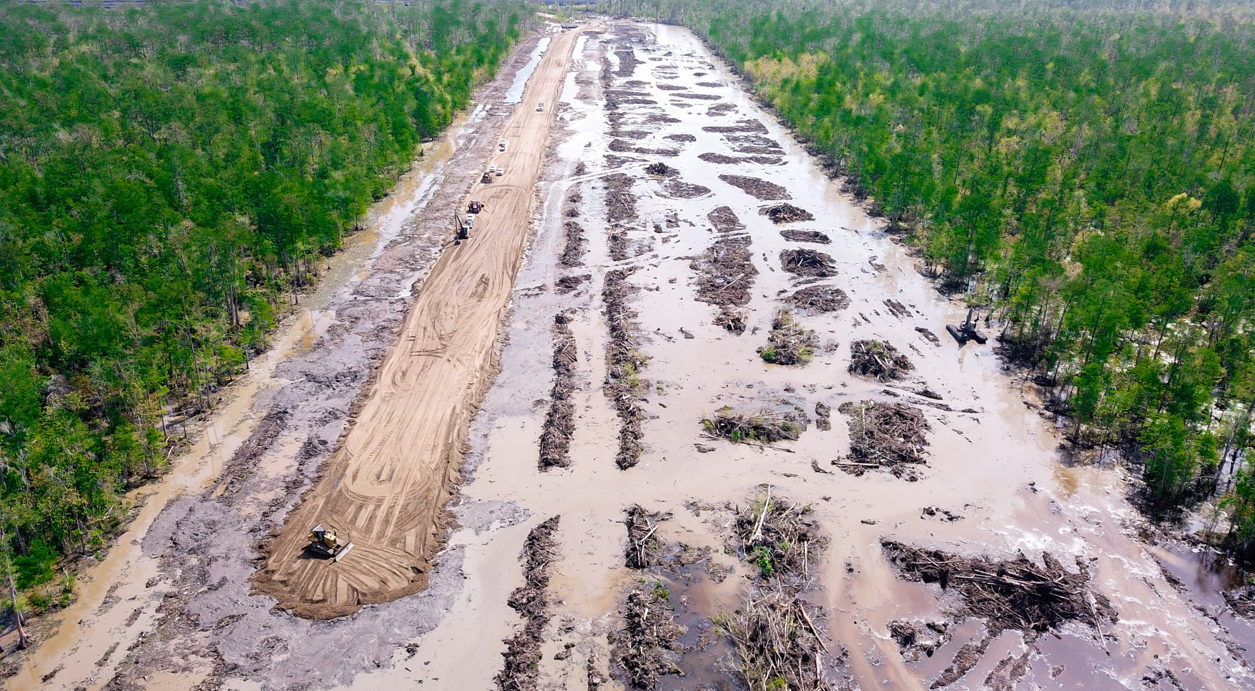
SPACEX LOUISIANA SUPPLIER DAY
CAPABILITY 01 · MARINE CONSTRUCTION
BUILT FOR LOUISIANA SOIL
Our crews have built extensively on Louisiana’s marsh. We offer the equipment and skills to build locally.
EQUIPMENT & LOGISTICS
SAPRIC SOIL CONDITIONS
HAUL ROAD CONSTRUCTION
Owned amphibious marsh excavators on pontoons work where standard machines cannot: marsh, soft banks, and open water edges.
The first 8 ft of organic material, sapric organic sediment (detrital peat), is stripped with amphibious equipment before embankment work.
We build haul roads across saturated ground by trucking in fill and spreading it with dozers. We maintain these access corridors and staging platforms for the life of the project.
09
Notes:
West Shore geology: first 8 ft organic stripped with amphibious equipment; chenier region parallel to WSLP. The 'coffee ground' soil is sapric organic sediment, also called detrital peat.

Slide 11
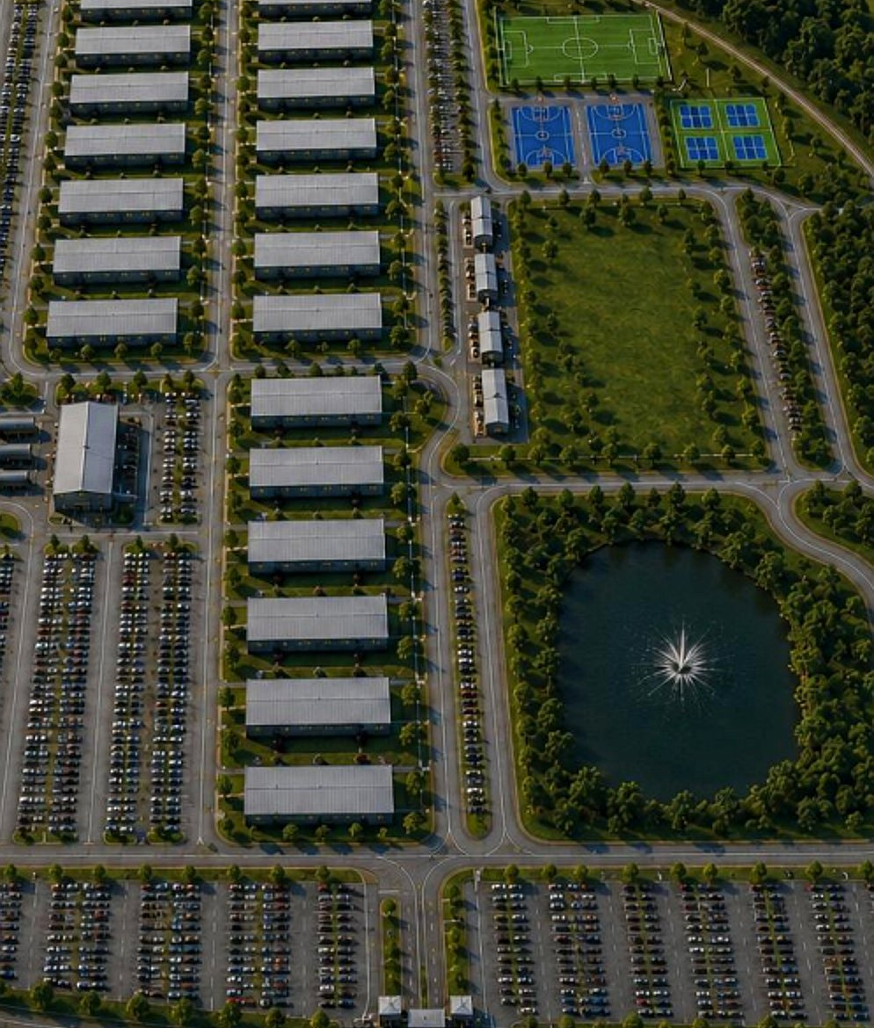
SPACEX LOUISIANA SUPPLIER DAY
CAPABILITY 02 · HOUSING
MANCAMPS & WORKFORCE HOUSING
CAMP BUILDOUT
LODGING OPERATIONS
Site prep, utilities, modular and trailerized billeting, installation, and commissioning.
Room assignment, housekeeping, linen service, and facility maintenance.
DINING & RECREATION
SECURITY & ADMIN
Full-service dining halls and recreation for extended-stay crews.
Front desk, badging, entry control, and perimeter patrol.
30,000
UP TO140
19,000
HOMES DELIVERED
HOMES DELIVERED IN A MONTH
MEALS SERVED THIS WEEK
10
Notes:
Mancamps and workforce housing. Capacity figures are on slide 12.

Slide 12
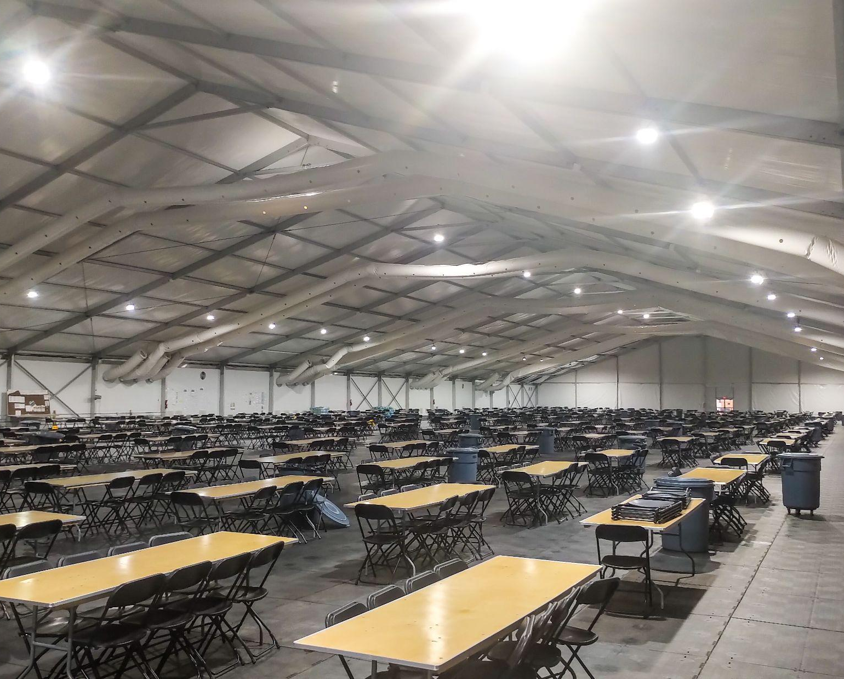
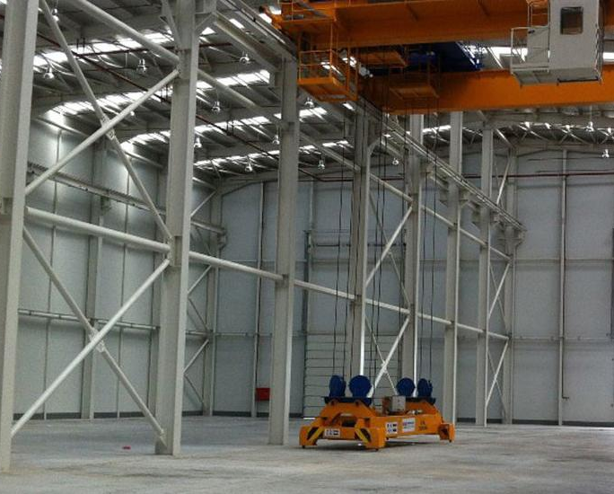
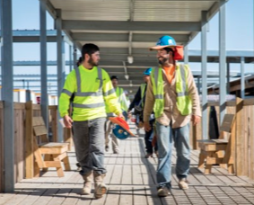
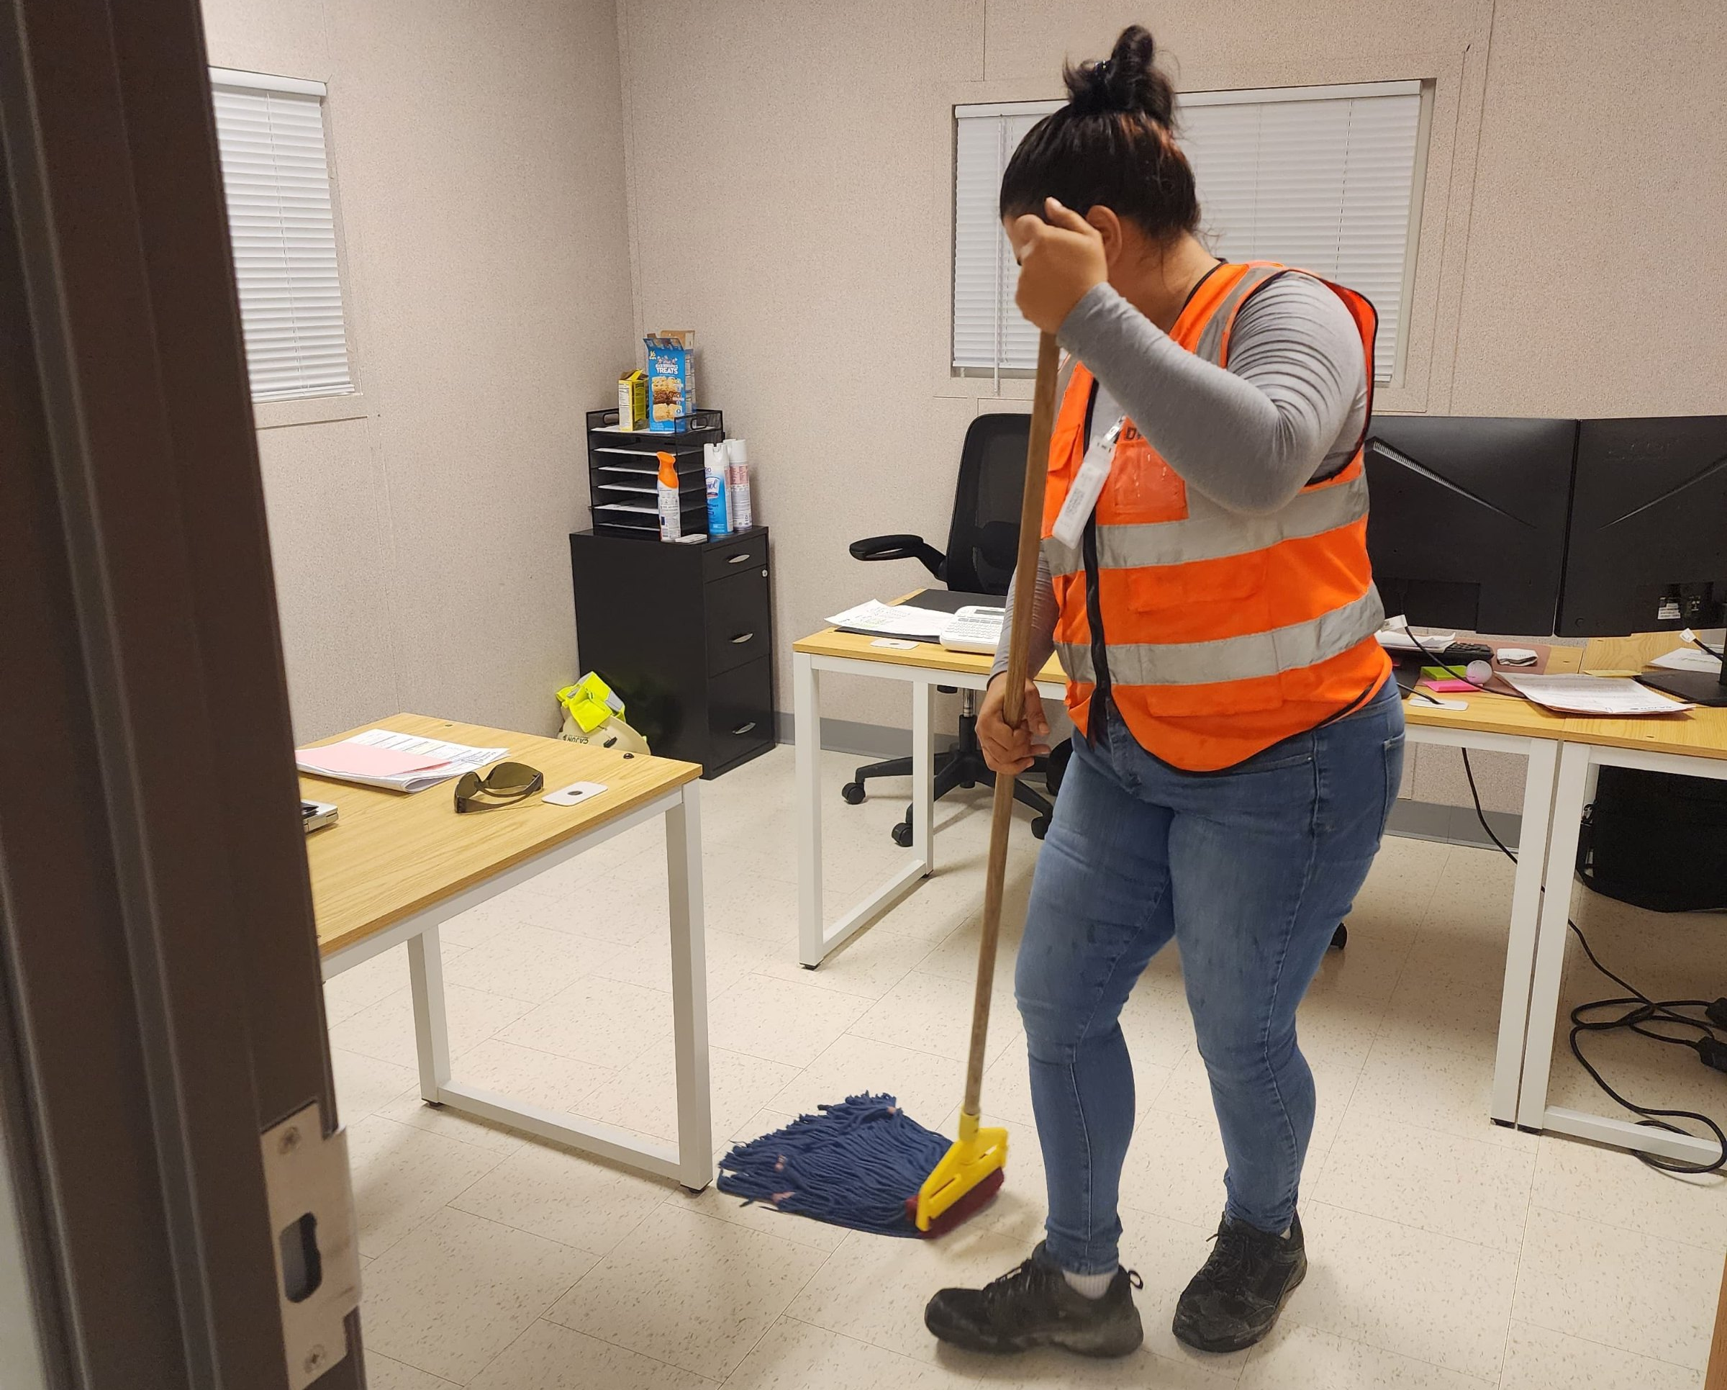
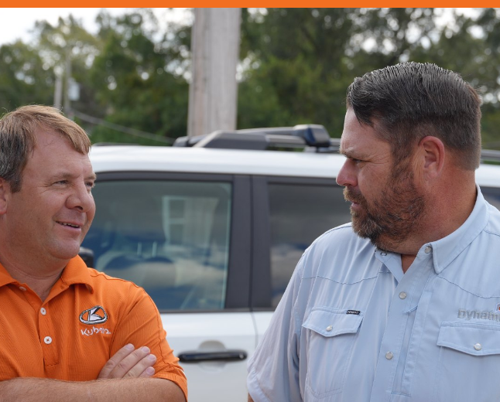
SPACEX LOUISIANA SUPPLIER DAY
CAPABILITY 03 · SITE LOGISTICS
KEEPING THE SITE RUNNING
The people, food, transport, storage, and janitorial and facility cleaning a large site needs every day, run by one accountable team so engineers can stay focused on the build.
CATERING
WAREHOUSING
EMPLOYEE TRANSPORT
JANITORIAL SERVICES
HIRE & SPEND LOCAL
Dining halls, boxed meals, and hydration stations sized to shift schedules.
Temporary warehouses, laydown yards, receiving, and chain-of-custody tracking.
Busing and shuttle operations from lodging and park-and-ride lots to the gate.
Daily janitorial and facility cleaning for site offices, trailers, restrooms, and common areas.
We will make every effort to hire and spend local, and report those stats to SpaceX.
11
Notes:
Catering, warehousing, busing, janitorial and facility cleaning, hire local.

Slide 13
SPACEX LOUISIANA SUPPLIER DAY
QUALITY & SAFETY
COMMITMENTS TO QUALITY & SAFETY
USACE QC PROCESS
SAFETY FOCUS
A QC manager on every site, with CQM-certified staff
Dedicated safety coverage with every field team
SAFETY PROGRAM
01
Stop work authority
02
Training program
03
All skilled labor are NCCER / NCCO certified
04
SPOT program for observations reporting
0.75
0 TRIR
1.9M
05
Monthly raffle for participating in the SPOT program
06
Hands-on onboarding and training, skills assessment
EMR RATING
TOTAL RECORDABLE INCIDENT RATE
ESTIMATED 2026 MANHOURS
12
Notes:
The reason why we have these strong number, 0.75 EMR, is because of our Safety Culture. Everyone has stop work authority. Our safety programs include.....

Slide 14
SPACEX LOUISIANA SUPPLIER DAY
PROJECT · HAUL ROADS & SOILS
WEST SHORE LAKE PONTCHARTRAIN
U.S. ARMY CORPS OF ENGINEERS · REACHES 104, 106, 109 + 114 · $142M
Four reaches of haul road construction and flood barrier work across the West Shore’s soft organic soils, with sheet piles jacked beneath live petrochemical lines and a T-wall on 200+ pipe piles driven to 130 ft under I-10.
23,000+
100,000
795,000
LF OF FLOOD BARRIERS
TONS OF SAND, NEXT PHASE
CY COMPACTED CLAY
200+
4.5
458,500
PIPE PILES DRIVEN
MILES OF HAUL ROAD UNDER CONTRACT
MAN-HOURS WORKED
13
Notes:
Specialized pneumatic hammer
Low vibration, low noise
That’s the kind of solution we bring to a complex project like this
WSLP Reaches 104, 106, 109 and 114, $142M. 23,000+ LF of coastal barriers, 795,000 CY compacted clay; next phase 100,000 tons sand and 215,000 CY clay. 4.5 miles of haul road currently under contract. 458,500 man-hours worked.

Slide 15
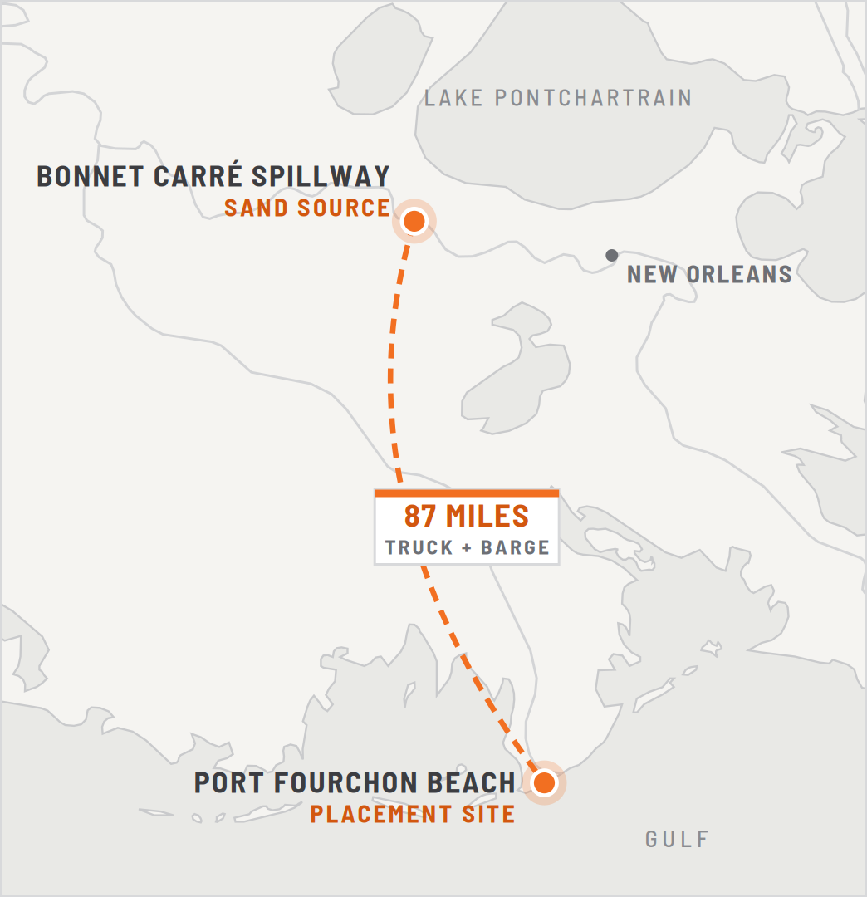
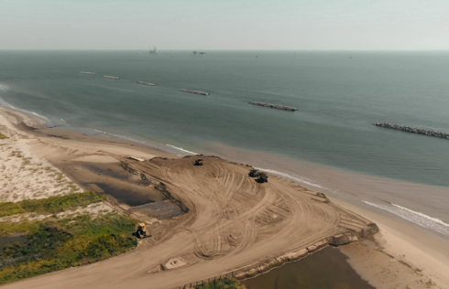
SPACEX LOUISIANA SUPPLIER DAY
PROJECT · COASTAL RESTORATION
PORT FOURCHON COASTAL RESTORATION
SAND HAULING · BARGING · PLACEMENT · LAFOURCHE PARISH
Transported 614,000 tons of sand over 87 miles to rebuild eroded beaches and strengthen natural storm barriers. Trucked sand to the landing, loaded it onto barges by conveyor and excavator, and pushed it across the channel by push boat. Placed the material in water with conventional and amphibious equipment, then graded it into an engineered shoreline built outward from the water.
614,000
87
Turnkey
TONS OF SAND TRANSPORTED
MILE HAUL DISTANCE
CONTRACTOR, HAUL THROUGH PLACEMENT
14
Notes:
Port Fourchon coastal restoration: sand hauling, barging and placement. 614,000 tons over 87 miles, truck to barge to placement, turnkey from haul through placement. Same remote coastal logistics apply at Starbase.

Slide 16
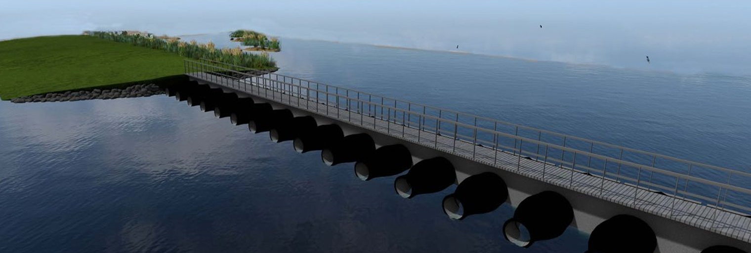
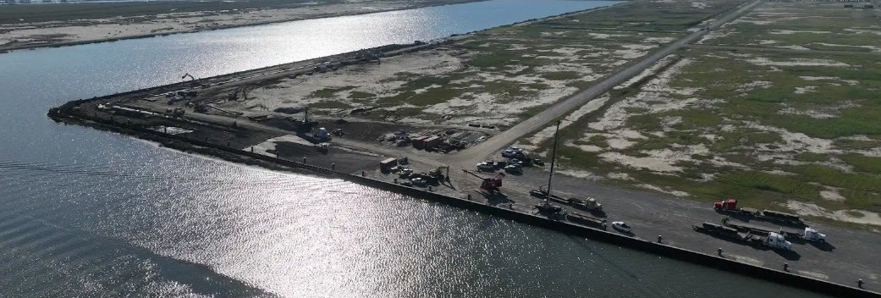
SPACEX LOUISIANA SUPPLIER DAY
PROJECT · MARINE
MARINE PROJECTS
MARSH & HYDROLOGIC RESTORATION
PORT BULKHEAD EXPANSION
COASTAL PROTECTION AND RESTORATION AUTHORITY · $104.9M
GREATER LAFOURCHE PORT COMMISSION · $16.5M
Seven drainage structures on Lake Calcasieu with precast T-walls: 1,024 H-piles, 94,310 SF of sheet piles, 306,000 CY of dredging, and 159 60-inch gravity valves. Water access only, by barge and boat.
Slip D: 1,641 LF of steel sheet pile driven to 50 ft on 588 precast concrete piles, with a 195,500 SF work area and 13,000 CY of lightweight aggregate backfill.
15
Notes:
Marine projects: Marsh & Hydrologic Restoration ($104.9M, seven drainage structures, 1,024 H-piles, 94,310 SF of sheet piles, Cameron Parish) and the Slip D bulkhead at Port Fourchon.
- Largest coastal restoration project in the state for Michael Hare and the governor’s team
- Interesting gravity valves that allows water

Slide 17
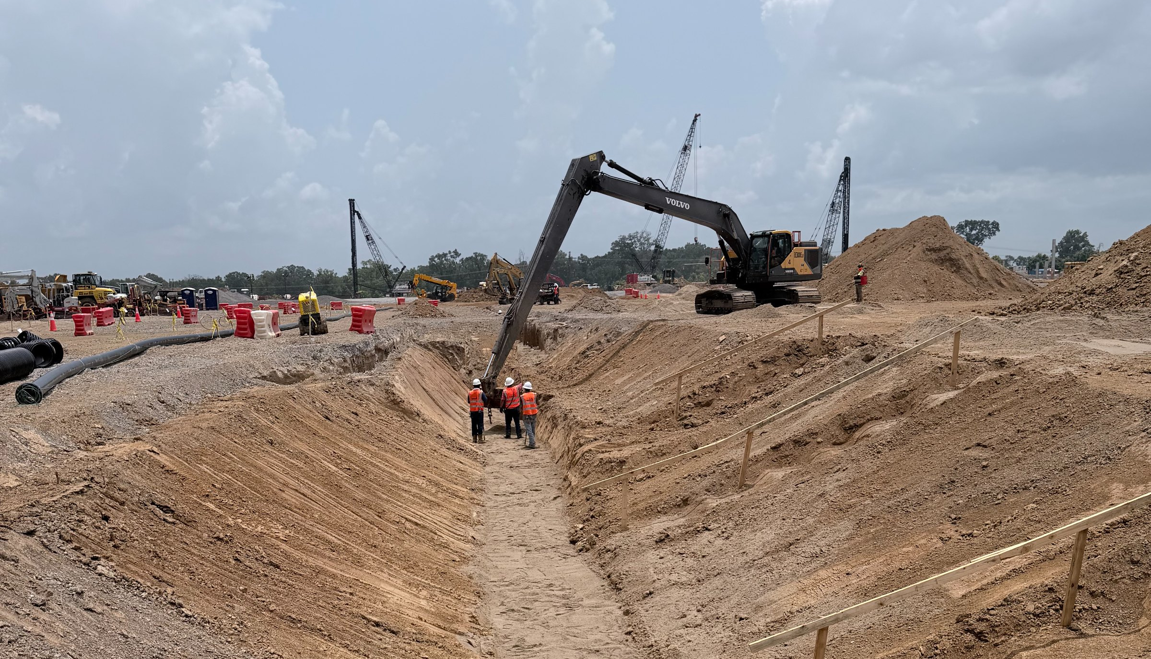
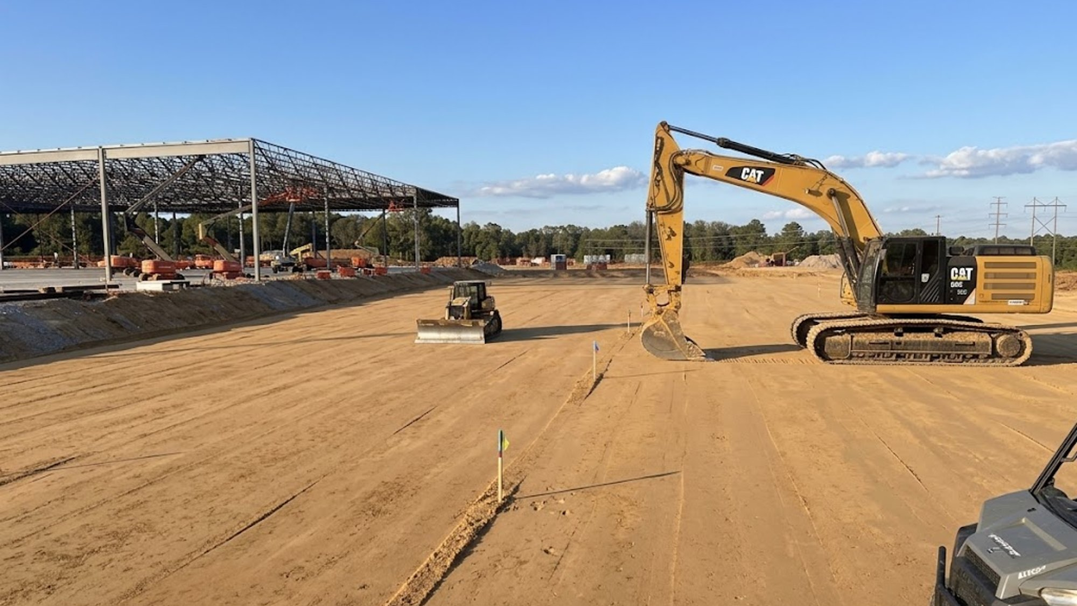
SPACEX LOUISIANA SUPPLIER DAY
PROJECT · MEGA SITE OPERATIONS
CONFIDENTIAL HYPERSCALE DATA CENTERS
LOUISIANA & TEXAS · MARCH 2026 – CURRENT
SCOPE OF WORK
SITE OPERATIONS
LOGISTICS
CATERING
WORKFRONT SUPPORT
LABOR TRANSPORT
LAYDOWN YARD CREATION
CIVIL
TEMPORARY UTILITIES
CONCRETE
INTERIOR FIT OUT
500+
19,000
15,000+
PERSONNEL ON SITE
MEALS SERVED THIS WEEK
WEEKLY MANHOURS
16
Notes:
Mega site operations and logistics. 500+ personnel on site. 19,000 meals served this week. 15,000+ weekly manhours. Scope: site operations, logistics, catering, workfront support, labor transport, laydown yard creation, civil, temporary utilities, concrete, interior fit out. March 2026 to current. Locations: Louisiana and Texas.

Slide 18
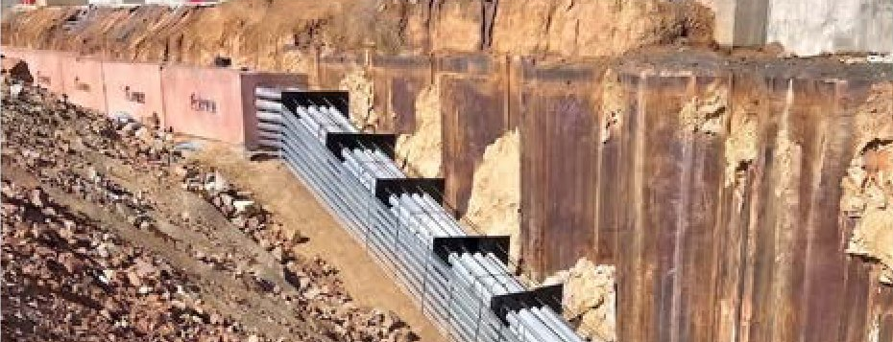
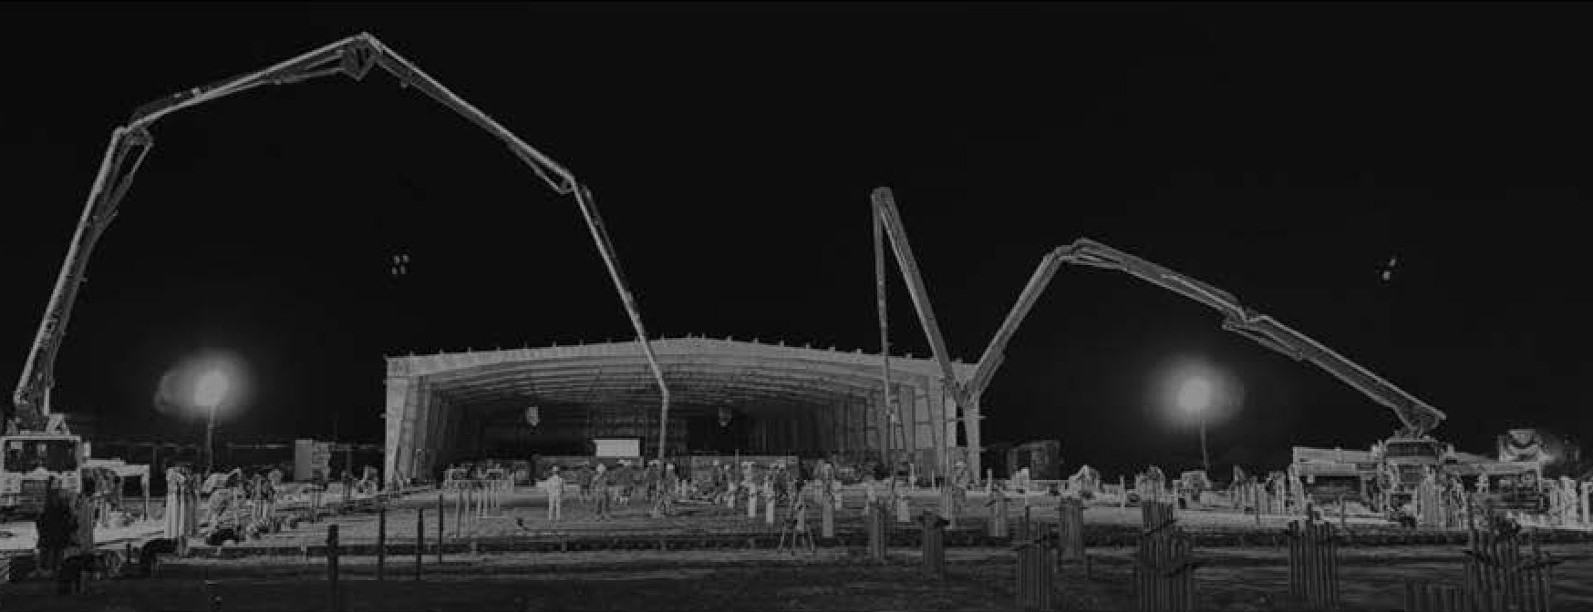
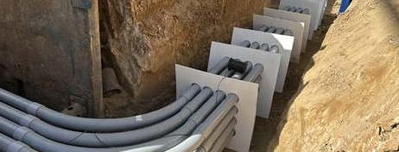
SPACEX LOUISIANA SUPPLIER DAY
PROJECT · CONCRETE & SUBSURFACE INFRASTRUCTURE
CAST IN PLACE, MODULAR & PRECAST
CAST-IN-PLACE AND PRECAST DUCT BANK
55,000 LF
SUBSURFACE INFRASTRUCTURE CURRENTLY UNDER CONTRACT
INFRASTRUCTURE & UTILITIES
FOUNDATIONS & PLACEMENT
Cast-in-place, precast, and modular duct banks and vaults
Driven H-pile, pipe pile, and precast concrete piles
OVERNIGHT POUR, TWO BOOM PUMPS
Direct-buried and encased conduit for power, fiber, and controls
Drilled shafts, pile caps, and grade beams
On-site batch plant and volumetric mixers for high-volume pours
Deep excavation with shoring; vaults and manholes set
Directional boring
MODULAR DUCT BANK
17
Notes:
Right now, we have 55,000 LF of subsurface infrastructure under construction
Duct banks in all three delivery methods: cast in place, precast, and modular. Directional boring. 55,000 LF of subsurface infrastructure currently under contract. Full concrete scope managed under Dynamic's direct quality oversight, with on-site batch plants and volumetric mixers.

Slide 19
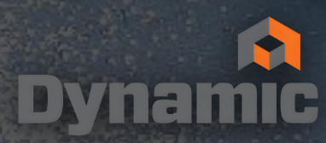
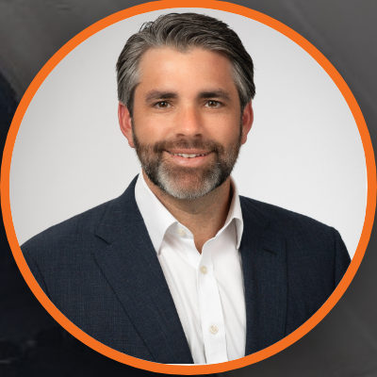
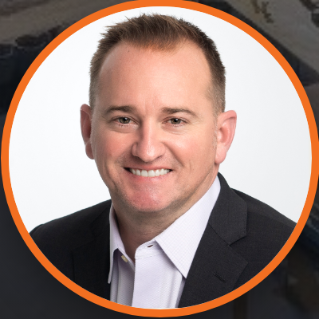
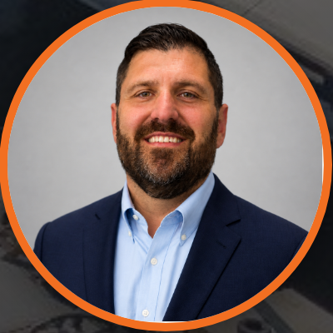
DYNAMICGRP.COM
GET IN TOUCH
YOUR DYNAMIC TEAM
ZACH BUTTERWORTH
JOSH MCCOY
JOHN AUSTIN
CHIEF EXECUTIVE OFFICER
EXECUTIVE CHAIRMAN
EXECUTIVE VICE PRESIDENT
ZACHB@DYNAMICGRP.COM
JMCCOY@DYNAMICGRP.COM
JAUSTIN@DYNAMICGRP.COM
DYNAMIC GROUP | 3045 WESTFORK DRIVE, BATON ROUGE, LA 70816
18
Notes:
Close. Confirm which contacts SpaceX engineers should reach.

